Slide 1
Stochastic Path Finding
Aditya.V
CB.EN.P2AIE22003

Slide 2
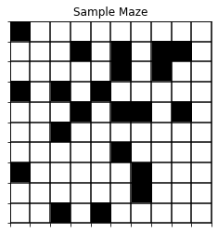
Simulation Environment
For simulation environment we create a simple binary maze of square matrices. A sample maze is illustrated below

Slide 3
White cells are empty while black cells denote walls. An agent can move into a white cell but not into a black cell.
We test the efficacy of different search algorithms in traversing such a maze.
Specifically we use the following search algorithms
BFS
DFS
Dijkstra's
A*-L2
A*-L1
Stochastic Search

Slide 4
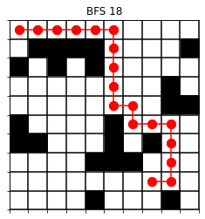
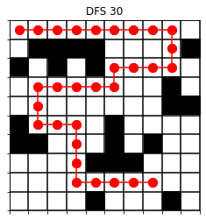
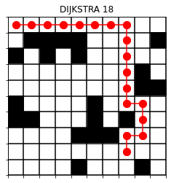
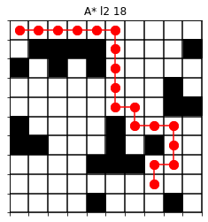
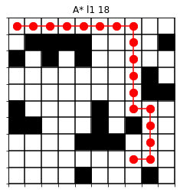
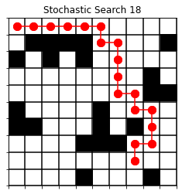
Traversal path of different search algorithms

Slide 5
GitHub Repository/Code
https://github.com/AdityaViswa/Stochastic-Path-Finding

Slide 6
Thank You

